Slide 1
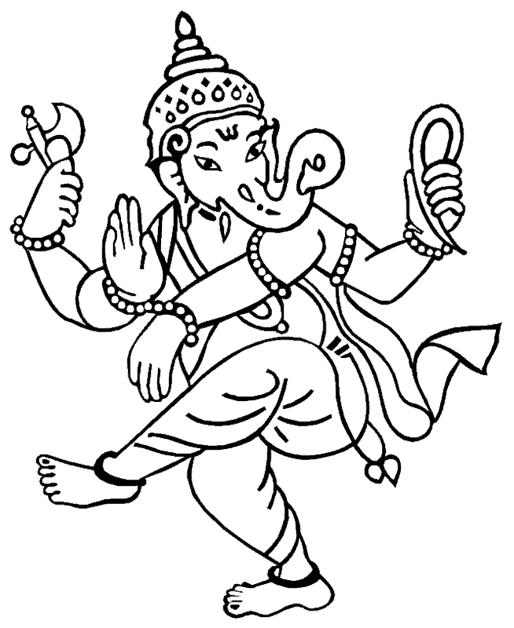
Ganesh Quang Huynh
Ganesh is a god of success and good luck. It is told that if you worship Ganesh, you can remove all of your difficulties and obstacles. Also, Ganesh is the son of Shiva and Parvati. Ganesh is also very popular and one of the most worshipped gods in the world. People generally worship Ganesh before making an important decision.

